Slide 1
Introduction to variability of flows and concentrations in watersheds
BAE204, 28 February 2019

Slide 2
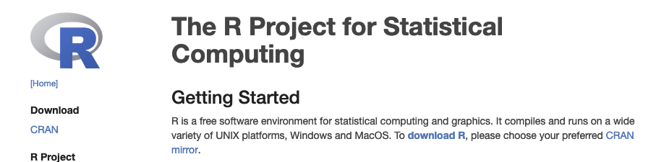
Download R
Google: ‘R project’
http://archive.linux.duke.edu/cran/

Slide 3

Download RStudio
Google: ‘rstudio download’

Slide 4
Starter code
ipak <- function(pkg){
new.pkg <- pkg[!(pkg %in% installed.packages()[, "Package"])]
if (length(new.pkg))
install.packages(new.pkg, dependencies = TRUE)
sapply(pkg, library, character.only = TRUE)
}
# usage
packages <- c("knitr", "captioner", "stringr", "devtools", "bookdown","kableExtra", "rmarkdown","blogdown","pander")
ipak(packages)

Slide 5
Using R to make websites, write books and articles
Websites
Articles
Books, chaptered docs

Slide 6
What’s this ***down business?
It starts with Markup language!

Slide 7
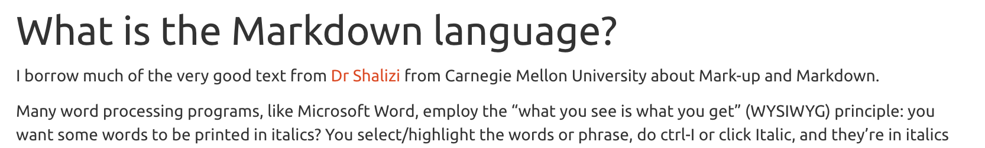
What is the Markup language?
<div id="what-is-the-markdown-language" class="section level2"> <h2>What is the Markdown language?</h2> <p>I borrow ... from <a href="http://www.stat.cmu.edu/~cshalizi/rmarkdown/">Dr Shalizi</a> from ...</p> <p>Many ...that of <em>marking up</em> text. The essential idea in a <strong>mark-up language</strong> is that it consists of ordinary text, <em>plus</em> signs which indicate how to change the formatting or meaning of the text. Some mark-up languages, like HTML (Hyper-Text Markup Language) use very obtrusive markup; others, like the language called <strong>Markdown</strong>, are more subtle.</p> </div>

Slide 8
Markup, Markdown
Play on word!
Markup: a bit on the complicated side (HTML, LaTeX, others)
Markdown: the idea is to make things simple:
<div id="what-is-the-markdown-language" class="section level2"> <h2>What is the Markdown language?</h2>
Becomes
## What is the Markdown language?

Slide 9
One code, several output formats
Markdown .md format recognized by many interpreter codes
Rmarkdown example outputs:
Documents:
Html documents
Pdf document (via LaTeX)
Word document
epub
Presentations:
Ioslides_presentations
Power point presentations
Other:
Interactive dashboards
Github_documents

Slide 10
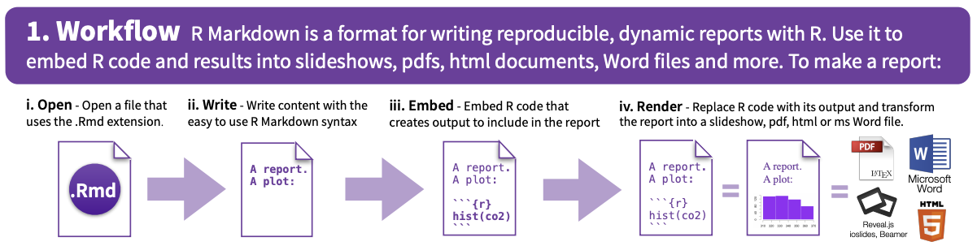
https://www.rstudio.com/wp-content/uploads/2015/02/rmarkdown-cheatsheet.pdf

Slide 11
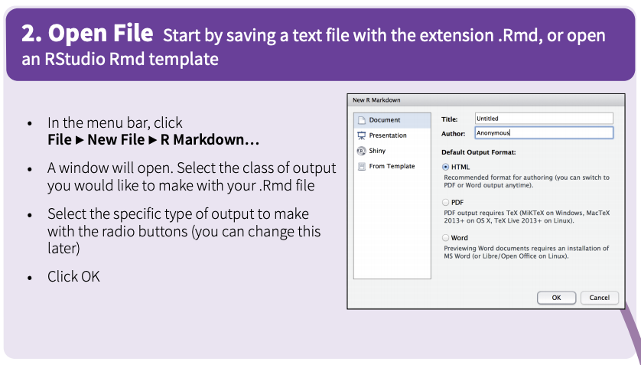

Slide 12
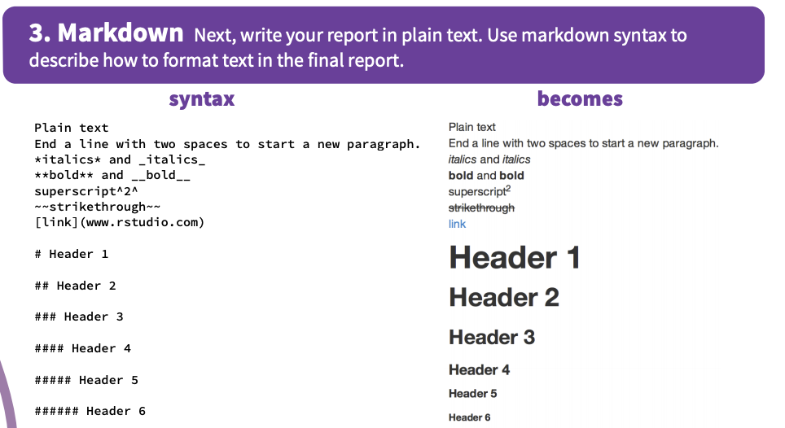

Slide 13
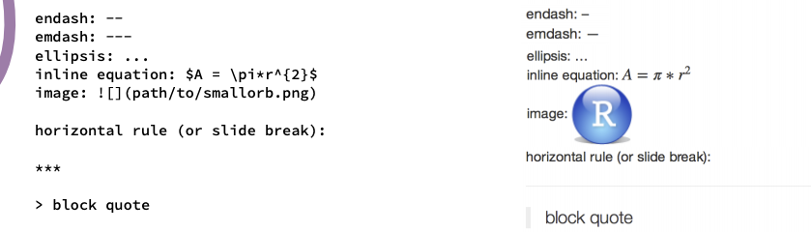

Slide 14
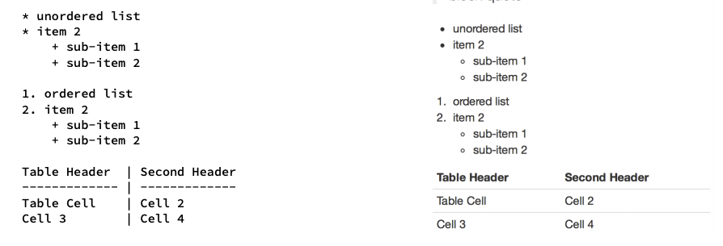

Slide 15
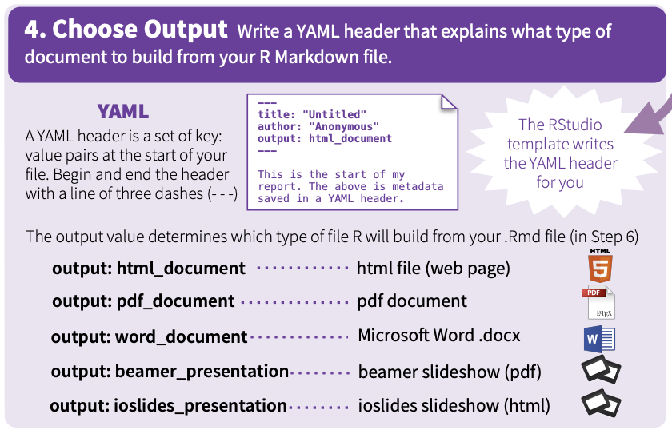

Slide 16
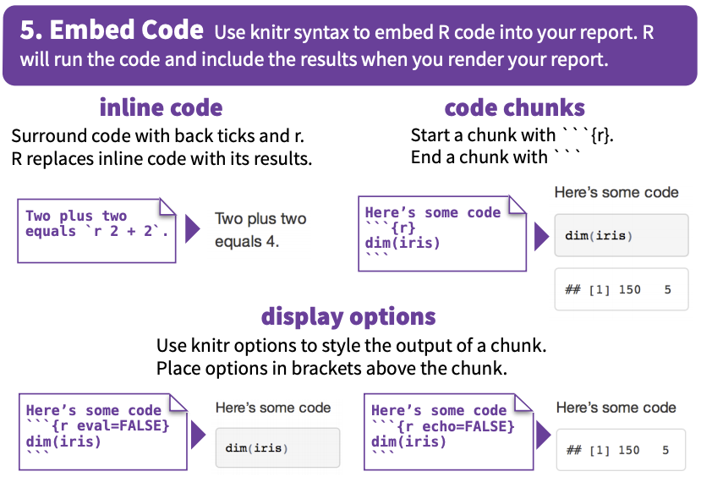

Slide 17
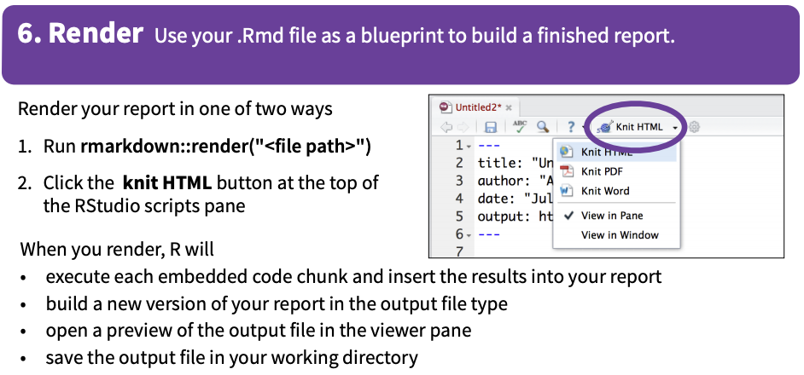

Slide 18
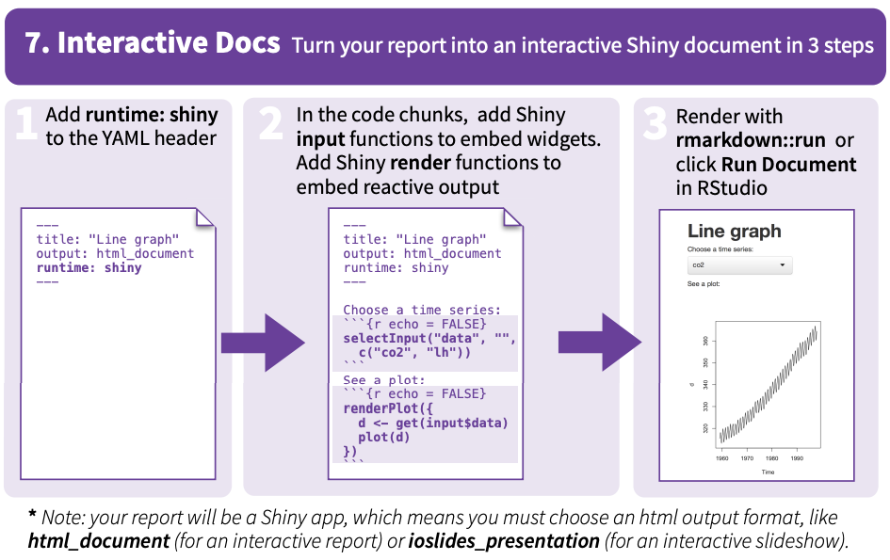

Slide 19
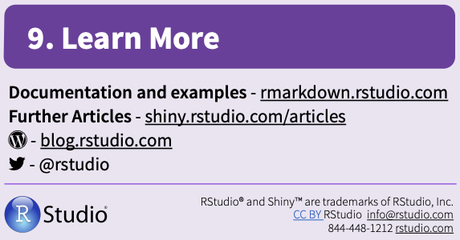

Slide 20
The basic structure
YAML header
Defines settings for the document
Text
Headings, alteration, cross-references, etc.
Code chunks
Interprets codes in R, python, C, and fortran
Rmarkdown, Bookdown, and blogdown KNIT all pieces together in homogeneous output

Slide 21
BAEBookExample
Go to https://github.com/francoisbirgand
Go to repositories
Choose BAEBookExample (https://github.com/francoisbirgand/BAEBookExample)
Download ZIP
Follow things on the screen!!!
And then have your first book online!!!

Slide 22
Scientific article template using bookdown
Download https://github.com/francoisbirgand/TemplateBookdownArticle

Slide 23
Making your own website
Download https://github.com/francoisbirgand/rmarkdown-website-tutorial

